Slide 1
QuTE: decentralized multiple testing on sensor networks with FDR control A. Ramdas, J. Chen, M. Wainwright, M. Jordan
Xiang Zhang

Slide 2
Outline
Motivation & Background
FDR control: Distributed VS Centralized
QuTE: Query-Test-Exchange
Methodology
Performance guarantee: proof of two theorems
Multi-round QuTE
Simulation
Erdos-Renyi random graph
Planar grid
Discussion
Notes:
Here is the sketch of what I will talk about today
We will do some quick reviews of the background knowledge
and then, proceed to the main algorithm, called query-test-and –exchange that controls the FDR in a distributed manner
This paper is like, contains two parts, the theory part and simulation.
We will do some of the proofs and then look at the simulation

Slide 3
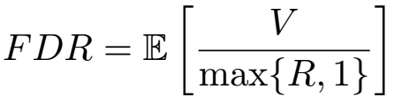





Background
FDR(False Discovery Rate)
BH procedure
Order the p-values:
Reject the smallest p-values:
Control at level
Notes:
False discovery rate is defined as the expected value of the false discovery portion,
A discovery is actually a rejection. So a false discovery refers to the rejection of the true null V,R
2.BH procedure, contains two steps, that is,
first, we compute the p-values and then order the them, and the smallest k hat of them are rejected, k hat is determined by this formula
BH procedure achieves the FDR control at the predefined level alpha

Slide 4
Motivation
Centralized control
A central entity with access to all N p-values
Perform BH procedure
Decentralized control
Wireless senor networks
Low power --> limited communication range
Each sensor has access to only a subset of p-values
Overall FDR control ?
Notes:
So , motivation
A centralized FDR control is like, you have a central server or something that collects all the p-values of the system, N is the total # of hypotheses
-- Doing the BH procedure, as we know, the FDR can be controlled at a certain level alpha
A decentralized algorithm , which is different from the decentralized setting, is like there is no such a central server that has access to all the p-values in the system.
Eg, in a wireless sensor network, due to the low battery capacity, each sensor has a limited communication range.
Let’s say, they can only commu. with their neighbors.
The problem is , how to do overall FDR control in this setting?

Slide 5





Query-Test-Exchange (QuTE)
Problem setup
Network represented by a graph:
Agent a is responsible for testing:
True null:
Total # of hypotheses:
Overall true null:
Communication model
Nodes only communicate with their neighbors
Perfect p-value transmission: no noise & quantization
Static topology, p-value, etc.
Notes:
This paper proposed a decentralized control method , which is called QuTE.
As the name suggests, the algorithm contains 3steps – query, test , & exchange
Here is the problem setup:
-- network is represented by a graph G which includes a vertex set V and edge set E
-- each sensor is associated with an agent, that is responsible for testing a set of hypos. H_a, and H_a^0 is the set of true nulls at sensor a
-- N total # hypo.
--H^0: the set of overall true nulls
--> p-values are not quantized, which means that they can be transmitted with unlimited accuracy

Slide 6




QuTE---Methodology
Initialization
Computes local p-vector:
Step 1: Query
Each agent queries its neighbors for their p-vectors
Denote as the set of p-values agent a gets after query
Step 2: Test
Agent a runs BH procedure on the p-values
Target level
Reject all p-values smaller than
Step 3: Exchange
Exchange rejection decisions among neighbors
Notes:
So here the way how QuTE algorithm works
---[ini] recall that each node is responsible for a set of n_a local hypos, they compute a p-vector.
the entries of this p-vector are just the p-values corresponding to each of the local hypos.
S2– the target level is set as alpha_a, which is proportional to the # of p-values node a can collect.
This threshold is essential in controlling the overall FDR, as we’ll see later

Slide 7
QuTE---Methodology
Query
Test
Each agent/node tests all the local p-values & those available at its neighbors (assume that no hypothesis is tested at two or more nodes, i.e., ’s are non-overlapping)
There might be computation redundancy (explain later)
Exchange
An agent rejects any local hypothesis rejected by its own test, or by the tests of any of its neighbors
Hypothesis rejected by any node will be rejected in the overall FDR control
Notes:
--So after the Query step, …
-- I the exchange step
This is how they QuTE algorithm works

Slide 8


QuTE---Performance guarantee
Theorem 1 Suppose that the p-values are independent, or positively dependent. Then for any graph topology, the QuTE algorithm achieves FDR control at level .
Performing local BH results in overall FDR control
Each agent only gather information from neighbors
Two extremes
>> empty graph: Bonferroni test ( )
>> complete graph: centralized BH
Notes:
This the main result of the paper---
--the theorem say that….
--[positively dependent] this is another assumption on the relation between different p-values, which has a formal definition in the references.
I will just ignore this cuz we can simply assume p-values are independent.
So, essentially, theorem 1 indicates that….
There are two extreme cases
--empty graph, meaning that there is no edges on the graph. Let’s assume that each node only tests one hypo.
Since each node gets nothing from other nodes, it only test the only one local hypo. This essentially becomes bonferroni test
--complete--> all nodes get all the p-values in the sytems

Slide 9




QuTE---Performance guarantee
Theorem 1 Suppose that the p-values are independent, or positively dependent. Then for any graph topology, the QuTE algorithm achieves FDR control at level .
Proof: denote as the overall # of rejections
define
>> maximum # of rejections among a and its neighbors
[Claim] is rejected iff. (since is rejected if it is locally rejected, or rejected by any of a’s neighbors)
Notes:
This should be pretty straightforward since if any neighbor of a, or a itself rejects P_{a,j}, then P_{a,j} is rejected by the algorithm.

Slide 10
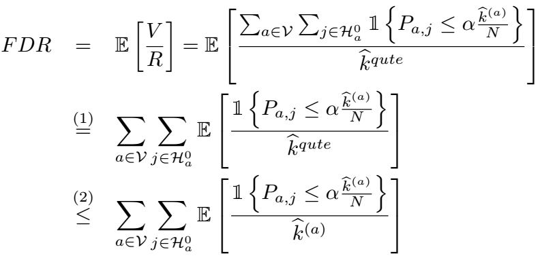

QuTE---Performance guarantee
Theorem 1 Suppose that the p-values are independent, or positively dependent. Then for any graph topology, the QuTE algorithm achieves FDR control at level .
Proof: [Claim] is rejected iff. .
Notes:
Just write down the definition of FDR
The indicator function means that the true null P_{a,j} is wrongly rejected
Step(1), just take the expectation into the summation
Step(2), we used the fact that… since that any local rejection will be a valid rejection of the QyTE algorithm.

Slide 11
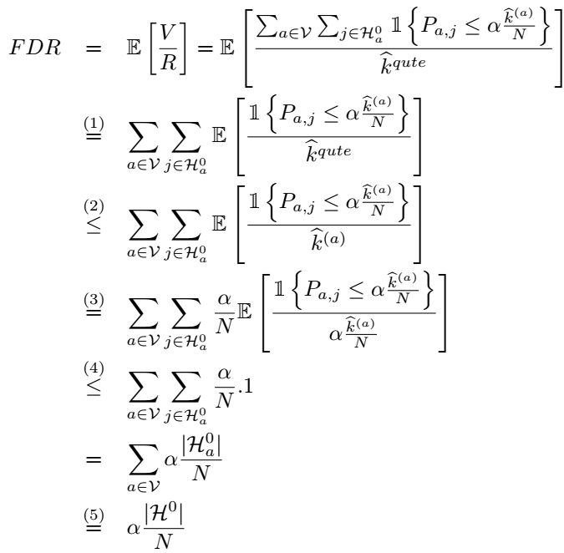

QuTE---Performance guarantee
Proof:
[Corollary]
Under independence
positive dependence,
this item is no greater
than 1. [ref 1,2]
Notes:
Step(3), we need to use some conclusion from the author’s previous result, which says that the expectation (circled by the red line ) is no greater than 1.
Using this fact, the following steps are straightforward and completes the proof.

Slide 12

QuTE---Multiple Rounds
Run the QuTE algorithm c (>1) times
Each node/agent can query p-vectors from all the other nodes within distance c.
Equivalent to enlarging the communication range
Performance guarantee
Theorem 2 Suppose that the p-values are independent, or positively dependent. Then the multi-step QuTE algorithm with c>1 rounds of communication guarantees that . .
>> Proof is essentially the same as Theorem 1
Notes:
This is an extension of the algorithm in which multiple rounds of communication is allowed .
This extension is equivalent to running the….. As a result, each node can reach more other nodes and collect more p-values.
The proof is almost the same and I’ll just skip that.

Slide 13
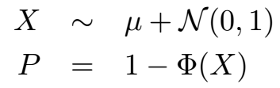




Simulation
Generation of p-values
for nulls and for alternatives
Target FDR:
Null-proportion:
Erdos-Renyi random graph G(N, p)
Any pair of vertices are connected w.p. p, in total N vertices
Planar grid
Rectangle and square grid

Slide 14
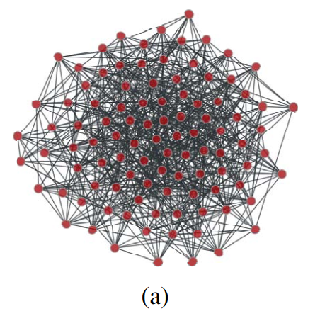
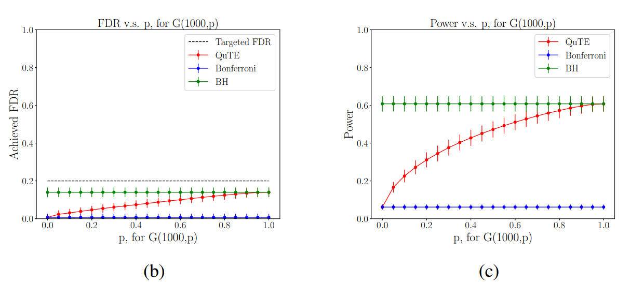
Simulation
Erdos-Renyi random graph G(N, p)
Any pair of vertices are connected w.p. p, in total N=1000 nodes, each testing one hypothesis

Slide 15
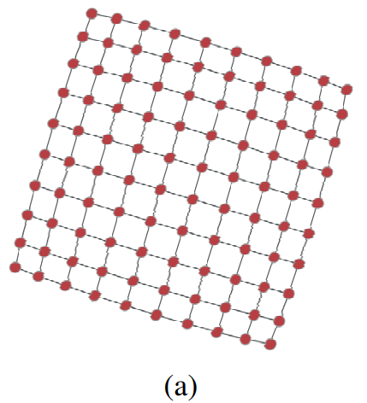
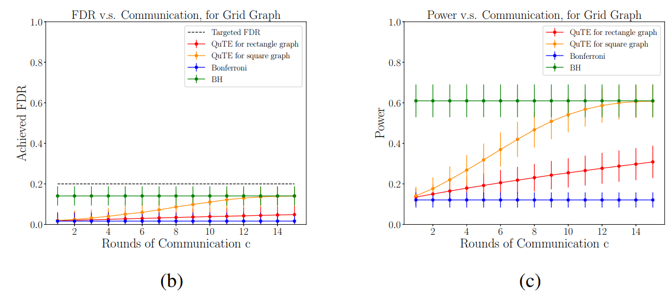
Simulation
Planar grid
N=256 nodes, each testing one hypothesis
Square grid 16*16
Rectangular grid 2*128

Slide 16
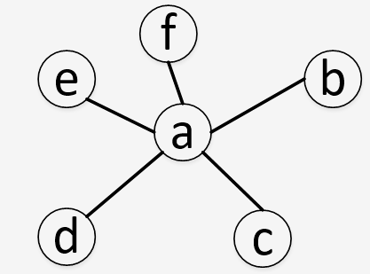
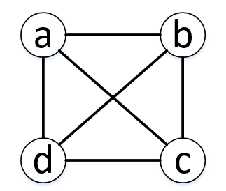
Discussion
Quantization error of p-values
>> Sensors with limited computation ability--> accuracy
>> Wireless channels are noisy
>> What is the effect of quantization?
Computation redundancy
>> As long as there exists one single node that are connected
to all the other nodes, QuTE becomes centralized BH procedure
>> For a complete graph, all nodes perform the same BH multiple
times--> unnecessary power consumption
>> Sampling
Notes:
One easy observation is that ‘as long as….’

Slide 17
References
[1] Barber, Rina Foygel, and Aaditya Ramdas. "The p‐filter: multilayer false discovery rate control for grouped hypotheses." Journal of the Royal Statistical Society: Series B (Statistical Methodology) 79.4 (2017): 1247-1268.
[2] Blanchard, Gilles, and Etienne Roquain. "Two simple sufficient conditions for FDR control." Electronic journal of Statistics 2 (2008): 963-992.

Slide 18
Thank you
Questions?

